Slide 1
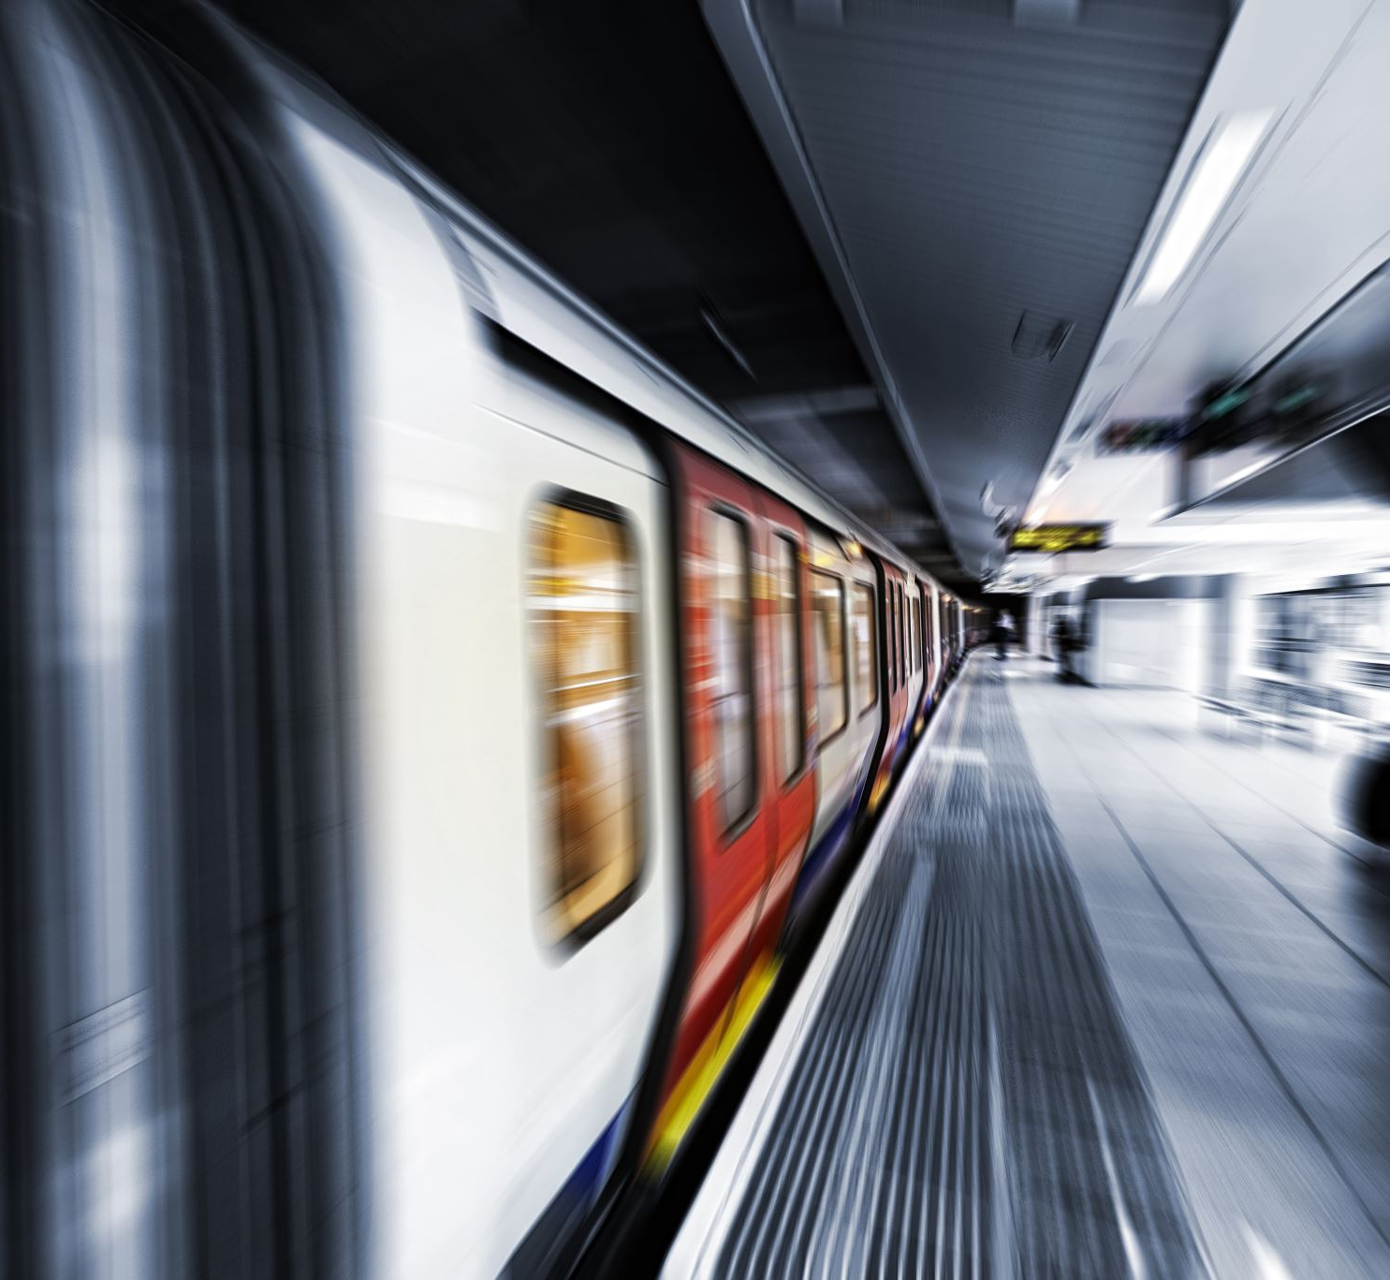
Train Ticket booking
Batch 90-Team 1
Afra Samiya Mukhaddas
Ashish Kumar Singh
Dhanush Meghanath
Disha Lotiya
Divya Sree Rage

Slide 2
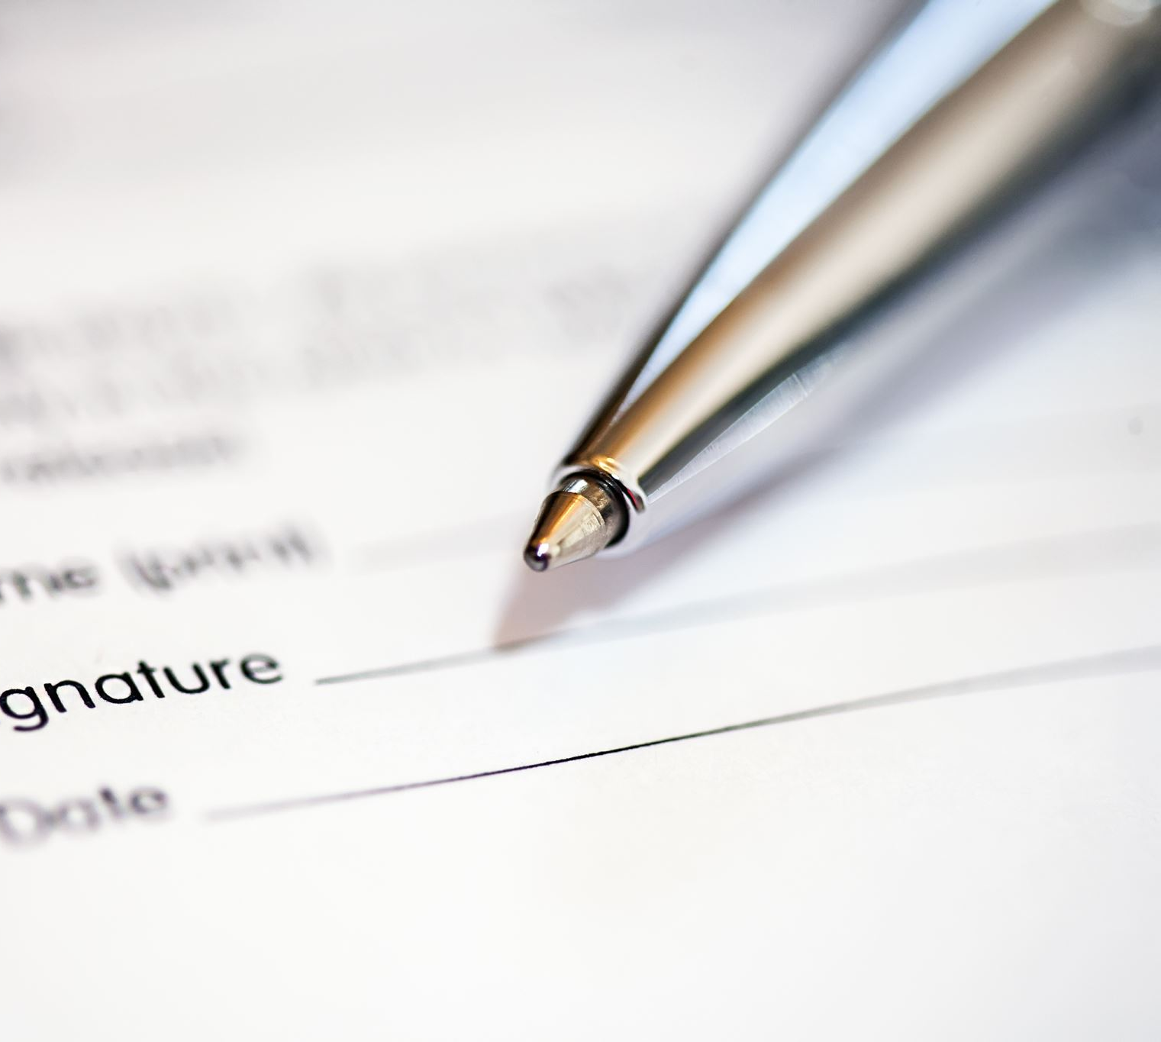
Contents
Problem Statement
Design
Technologies & Languages Used
Results

Slide 3
Problem Statement
As the technology has evolved where the passenger can reserve the tickets for their travel, cancel the reserve ticket and they can view the status of the ticket before travelling.
This application should take train number and passenger details as input.
The details of the train should be stored in a database. The train details to be stored in database are Train number, Train Name, Source Station, Destination Station and Ticket Price. The train details should be fetched from the database using the train number provided by the user.

Slide 4
Design
Start
Home
.
Search for trains
Admin Login
Searched Train
Admin Dashboard
Login
Logout
Registration page
Book Tickets
Payment

Slide 5
Technologies & Languages Used
Spring Boot
My sql
Java Script
Html
Css
JPA(HIBER NATE)

Slide 6
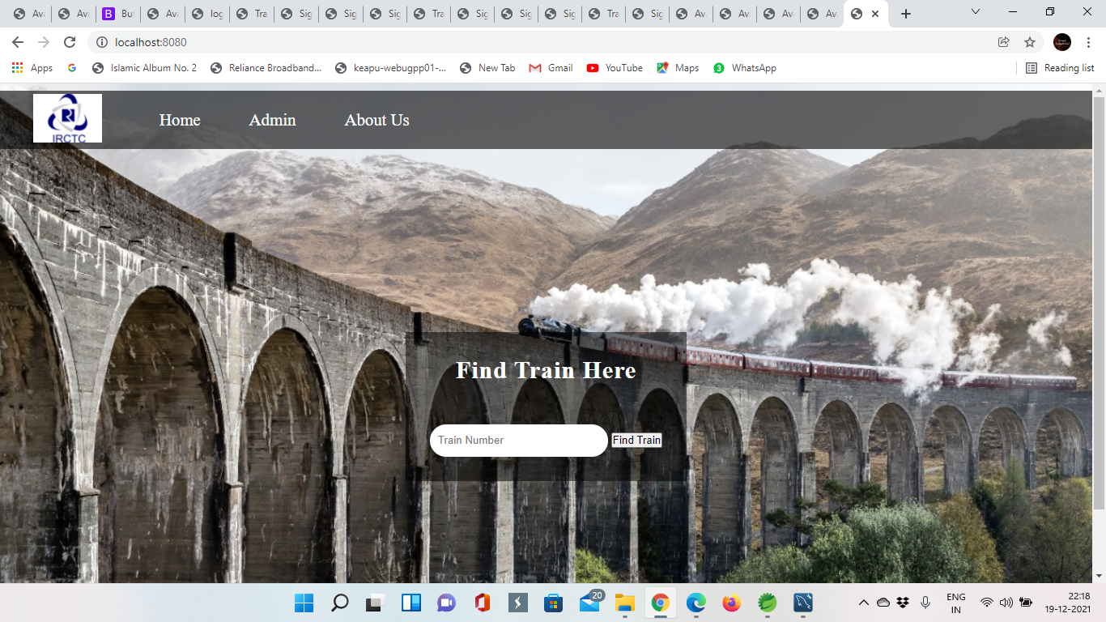
Results
Home Page

Slide 7
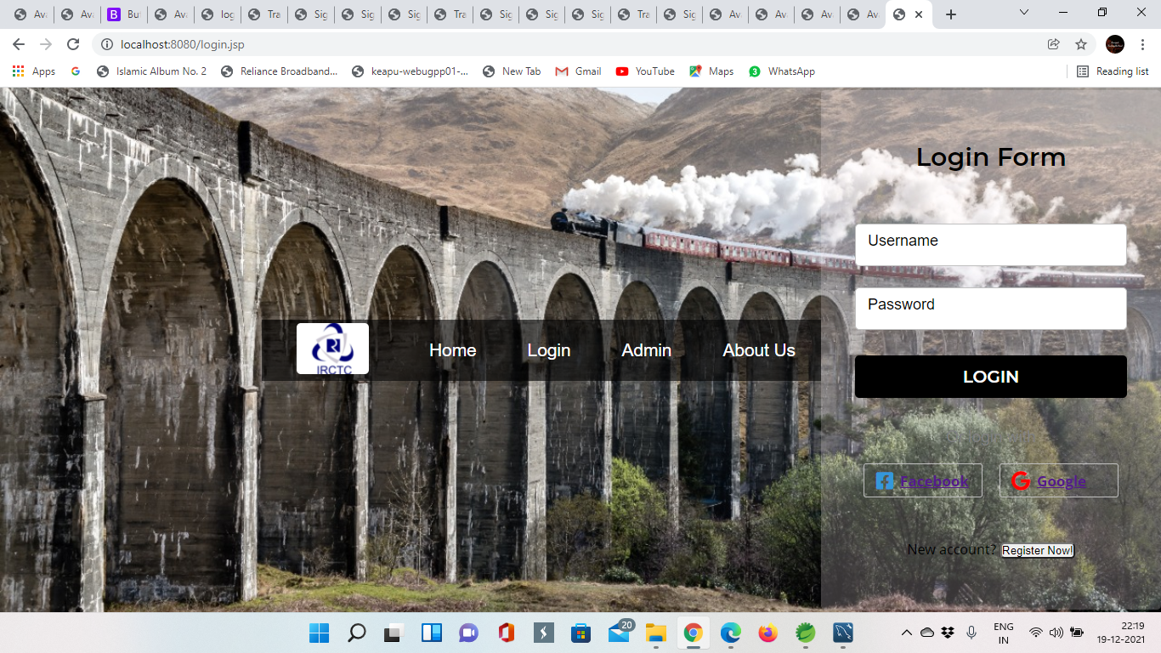
Login Page

Slide 8
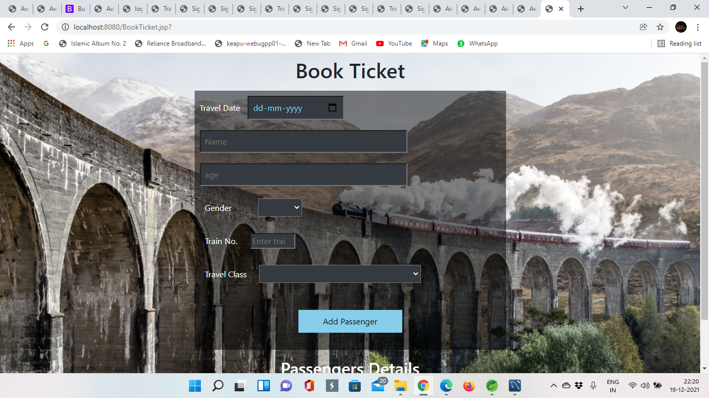
Book Ticket Page

Slide 9
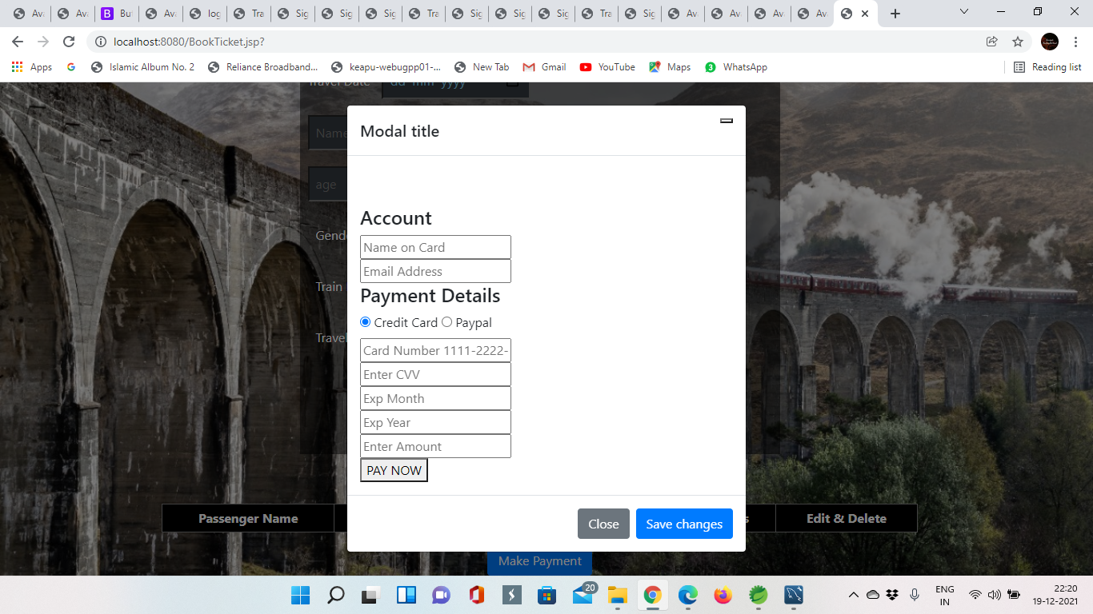
Payment Page

Slide 10
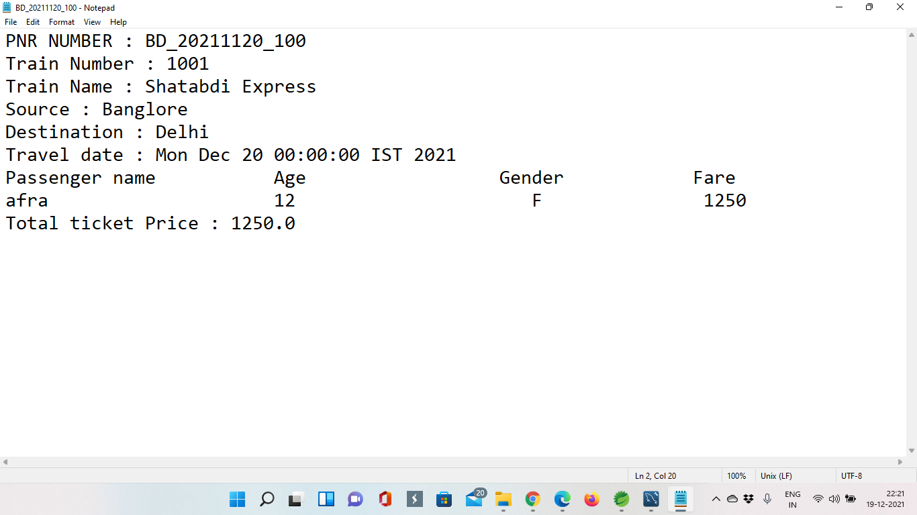
Ticket Page

Slide 11

Thank you

